Slide 1
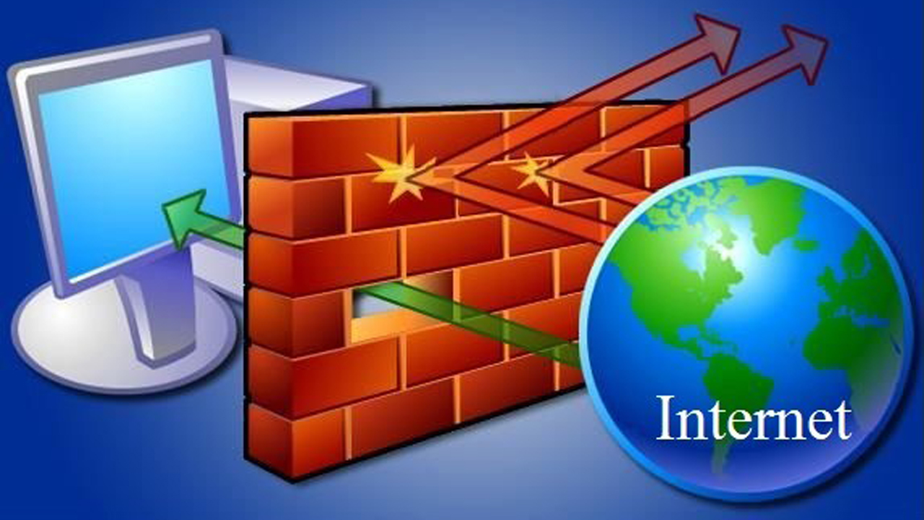
HƯỚNG DẪN CẤU HÌNH FIREWALL CISCO ASA
Nguyễn Văn Bình

Slide 2
PHẦN 1
Cisco Security Appliances
Overview

Slide 3
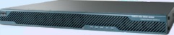
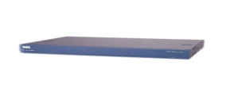
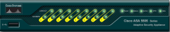
Các dòng Firewall Cisco ASA 5500
ASA 5550 - 5580
ASA 5540
Price
ASA 5520
ASA 5510
ASA 5505
Gigabit Ethernet
SOHO
ROBO
SMB
Enterprise
SP
Functionality
SP = service provider

Slide 4
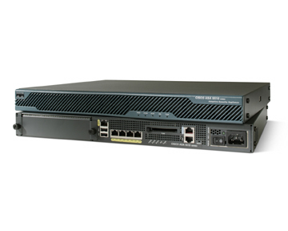
Cisco ASA 5510 Adaptive Security Appliance
Delivers advanced security and networking services, including high-performance VPN services, for small and medium-sized businesses and enterprise branch offices
Provides up to 130,000 concurrent connections
Provides up to 300-Mbps firewall throughput
Provides interface support
Up to 5 10/100 Fast Ethernet interfaces
Up to 25 VLANs
Up to 5 contexts
Supports failover
Active/standby
Supports VPNs
Site to site (250 peers)
Remote access
WebVPN
Supports optional SSMs (Cisco ASA AIP SSM, Cisco ASA CSC SSM, and four-port Gigabit Ethernet SSM)

Slide 5
Cisco ASA 5520 Adaptive Security Appliance
Delivers advanced security services, including high-performance VPN services, for medium-sized enterprise networks
Provides up to 280,000 concurrent connections
Provides up to 450-Mbps firewall throughput
Provides Interface support
4 10/100/1000 Gigabit Ethernet interfaces
1 10/100 Fast Ethernet interface
Up to 100 VLANs
Up to 20 contexts
Supports failover
Active/standby
Active/active
Supports VPNs
Site to site (750 peers)
Remote access
WebVPN
Supports optional SSMs (Cisco ASA AIP SSM, Cisco ASA CSC SSM, and four-port Gigabit Ethernet SSM)

Slide 6
Cisco ASA 5540 Adaptive Security Appliance
Delivers high-performance, high-density security services, including high-performance VPN services, for medium-sized and large enterprise networks and service provider networks
Provides up to 400,000 concurrent connections
Provides up to 650-Mbps firewall throughput
Provides Interface support
4 10/100/1000 Gigabit Ethernet interfaces
1 10/100 Fast Ethernet interface
Up to 200 VLANs
Up to 50 contexts
Supports failover
Active/standby
Active/active
Supports VPNs
Site to site (5,000 peers)
Remote access
WebVPN
Supports optional SSMs (Cisco ASA AIP SSM, Cisco ASA CSC SSM, and four-port Gigabit Ethernet SSM)

Slide 7
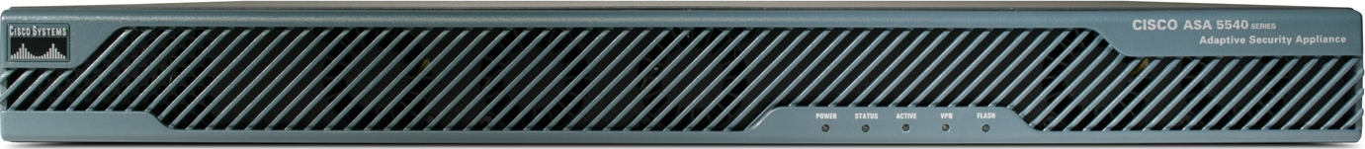
ASA 5510, 5520, and 5540 Adaptive Security Appliances Front Panel
Status
Flash
Power
Active
VPN

Slide 8
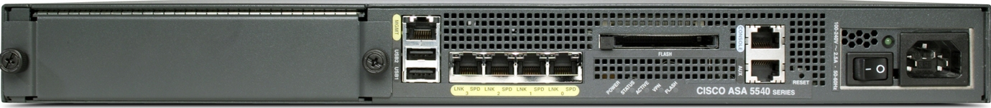
ASA 5510, 5520, and 5540 Adaptive Security Appliances Back Panel
CompactFlash
Fixed interfaces
Security services
module

Slide 9
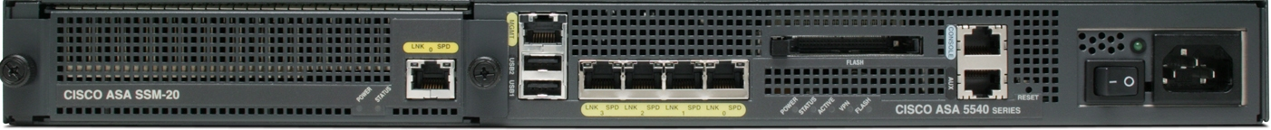
ASA 5510, 5520, and 5540 Adaptive Security Appliances Connectors
CompactFlash
10/100 out-of-band
management port
Console
port
Power supply
(AC or DC)
Four 10/100/1000
Gigabit Ethernet ports*
AUX ports
Two USB 2.0 ports
*ASA 5510 Adaptive Security Appliance supports 10/100 Fast Ethernet ports.

Slide 10
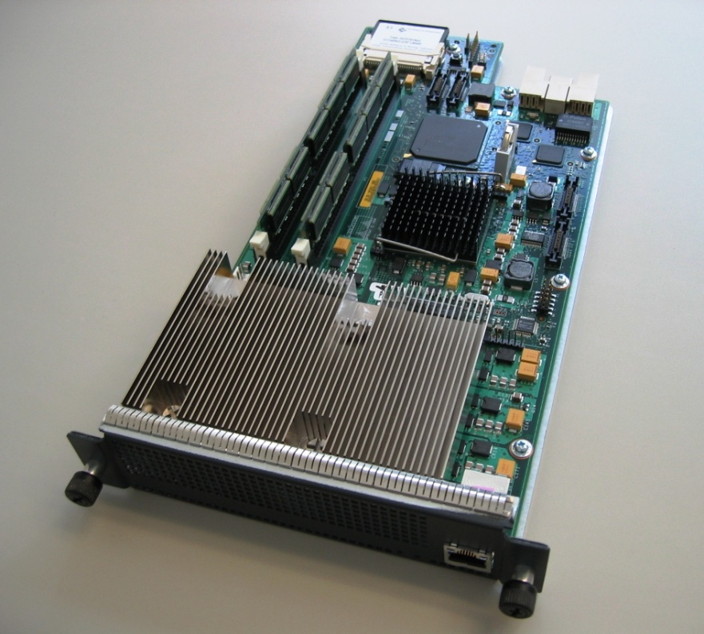
Cisco ASA Security Services Module
High-performance module designed to provide additional security services
Diskless (Flash-based) design for improved reliability
Gigabit Ethernet port for out-of-band management

Slide 11
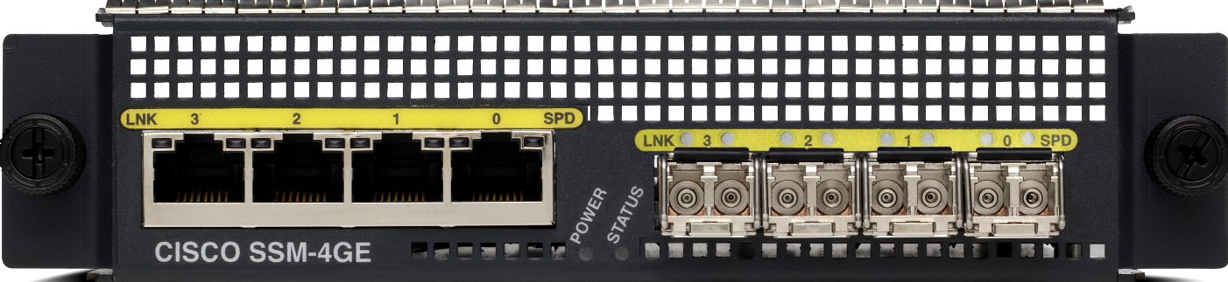
Four-Port Gigabit Ethernet SSM
RJ-45 link
LED
SFP link
LED
RJ-45
speed
LED
SFP
speed
LED
Status
LED
RJ-45
ports
Power
LED
SFP
ports

Slide 12
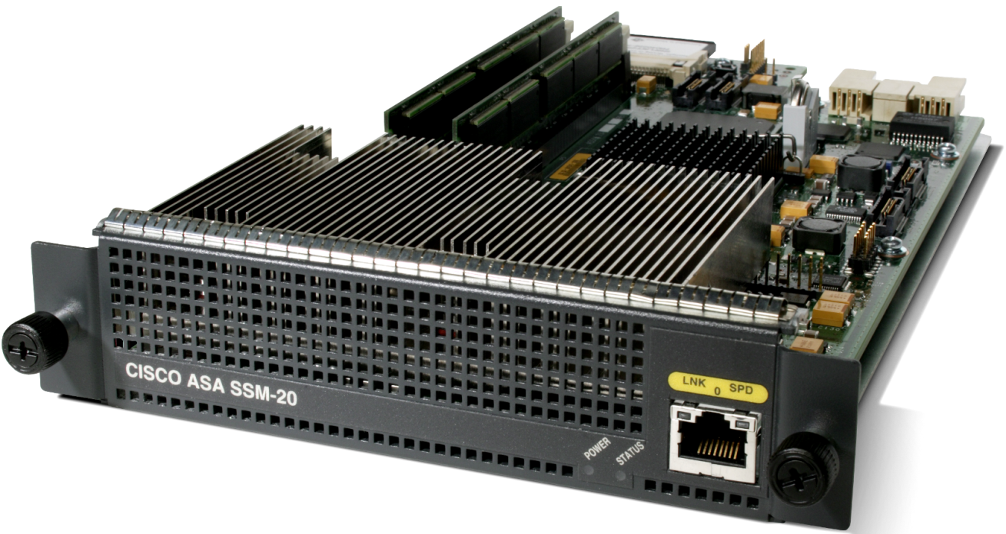
SSM Models
SSM-10
2.0-GHz processor
1.0 GB RAM
SSM-20
2.4-GHz processor
2.0 GB RAM
Speed
Link and activity
Power
Status

Slide 13
PHẦN 2
Getting Started with Cisco Security Appliances

Slide 14

Security Appliance Access Modes
A Cisco security appliance has four main administrative access modes:
Unprivileged
Privileged
Configuration
Monitor
ciscoasa>
ciscoasa#
ciscoasa(config)#
monitor>

Slide 15





Access Privileged Mode
Internet
ciscoasa>
enable [priv_level]
Used to control access to the privileged mode
Enables you to enter other access modes
ciscoasa> enable
password:
ciscoasa#

Slide 16
Access Configuration Mode
ciscoasa#
configure terminal
Used to start configuration mode to enter configuration commands from a terminal
ciscoasa#
exit
Used to exit from an access mode
ciscoasa> enable
password:
ciscoasa# configure terminal
ciscoasa(config)# exit
ciscoasa# exit
ciscoasa>

Slide 17
Viewing and Saving Your Configuration
The following commands enable you to view your configuration:
Show running-config
Show startup-config
The following commands enable you to save your configuration:
copy run start
write memory
To save configuration changes:
copy run start
startup-
config
(saved)
running-
config
Configuration
Changes

Slide 18
Erase Startup Configuration
Clear the Startup configuration:
startup-
config
running-
config
(default)
ciscoasa#
write erase

Slide 19
Reload the Configuration
ciscoasa#
reload [at hh:mm [month day | day month]] [cancel] [in [hh:]mm] [max-hold-time [hh:]mm] [noconfirm] [quick] [reason text] [save-config]
Reboots the security appliance and reloads the configuration
Allows scheduled reboots
ciscoasa# reload
Proceed with reload?[confirm] y
Rebooting...

Slide 20

Displaying Stored Files
Internet
ASA
disk0:
disk1:
ciscoasa#
dir [/all] [/recursive] [all-filesystems] [disk0: | disk1: | flash: | system:]
Display the directory contents
ciscoasa# dir
Directory of disk0:/
8 -rw- 8202240 13:37:33 Jul 28 2006 asa721-k8.bin
1264 -rw- 5539756 13:21:13 Jul 28 2006 asdm-521.bin
62947328 bytes total (49152000 bytes free)

Slide 21

show commands
show run interface
show interface
Show interface ip brief
show memory
show cpu usage
show version
show ip address
show nameif
show run nat
show run global
show xlate
show route
Internet
10.0.1.11
X.X.X.X
10.0.1.X
NAT
10.0.1.4
Internet
10.0.1.X
10.0.1.11
Mapped Pool
192.168.1.20-192.168.1.254
10.0.1.4

Slide 22
PHẦN 3
Appliance Access Management

Slide 23
Assigning a Hostname
Changes the hostname in the security appliance CLI prompt
New York ( asa1)
Server
Boston
(asa2)
Internet
Server
Dallas
(asa3)
Server
ciscoasa(config)#
hostname newname
ciscoasa(config)# hostname asa1 asa1(config)#

Slide 24

Configuring Remote Access Password
Telnet
10.0.0.11
Internet
password: telnetpass
ciscoasa(config)#
passwd password [encrypted]
Sets the password for Telnet access to set the security appliance
asa1(config)# passwd telnetpass

Slide 25
Configuring Enable (Privileged) Password
10.0.0.11
Internet
ciscoasa(config)#
enable password password
Sets the password for Privileged mode
ciscoasa(config)# enable password mysecretpassword

Slide 26
Configuring Telnet Access
Telnet
10.0.0.11
Internet
ciscoasa(config)#
telnet {{hostname | IP_address mask interface_name} | {IPv6_address interface_name} | {timeout number}}
Enables you to specify which hosts can access the security appliance console with Telnet and set the maximum time a console Telnet session can be idle before being logged off by the security appliance
ciscoasa(config)#
passwd password [encrypted]
Sets the password for Telnet access to set the security appliance
asa1(config)# telnet 10.0.0.11 255.255.255.255 inside
asa1(config)# telnet timeout 15
asa1(config)# passwd telnetpass

Slide 27
Configuring SSH Access
Removes any previously generated RSA keys
ciscoasa(config)#
ciscoasa(config)#
crypto key zeroize {rsa | dsa} [label key-pair-label] [default] [noconfirm]
crypto key generate rsa [usage-keys | general-keys] [label key-pair-label] [modulus size] [noconfirm]
Generates an RSA key pair
ciscoasa(config)#
ciscoasa(config)#
write memory
ssh {ip_address mask | ipv6_address/prefix} interface
Saves the CA state
Specifies the host or network authorized to initiate an SSH connection
ciscoasa(config)#
ciscoasa(config)#
domain-name name
ssh timeout number
Configures the domain name
Specifies how long a session can be idle before being disconnected

Slide 28

Configuring SSH Access Example
username: pix
password: telnetpassword
SSH
Internet
172.26.26.50
asa1(config)# crypto key zeroize rsa
asa1(config)# write memory
asa1(config)# domain-name cisco.com
asa1(config)# crypto key generate rsa modulus 1024
asa1(config)# write memory
asa1(config)# ssh 172.26.26.50 255.255.255.255 outside
asa1(config)# ssh timeout 30

Slide 29
Configuring User Authentication
ciscoasa(config)#
username username {nopassword | password} password
[encrypted] [privilege privilege_level]
Creates user account
aaa authentication {serial | enable | telnet | ssh | http} console {AAA_group_tag | [LOCAL]}
Enables authentication for appliance access controlling
ciscoasa(config)#username ciscoadmin password adminpassword privilege 15
ciscoasa(config)# aaa authentication ssh console LOCAL
ciscoasa(config)# aaa authentication http console LOCAL
ciscoasa(config)# ssh 10.0.1.0 255.255.255.0 inside
ciscoasa(config)# http 10.0.1.0 255.255.255.0 inside

Slide 30
PHẦN 4
Basic Security Appliance Configuration

Slide 31
Interface Name & Security Level
DMZ Network
GigabitEthernet0/2
Security level 50
Interface name = DMZ
g0/2
Internet
g0/0
g0/1
Outside Network
Inside Network
GigabitEthernet0/0
Security level 0
Interface name = outside
GigabitEthernet0/1
Security level 100
Interface name = inside

Slide 32
interface Commands
Enters configuration mode for the interface you specify
GigabitEthernet0/2
g0/2
Internet
g0/0
g0/1
GigabitEthernet0/0
GigabitEthernet0/1
ciscoasa(config)#
interface {physical_interface[.subinterface] | mapped_name}
asa1(config)# interface GigabitEthernet0/0
asa1(config-if)#

Slide 33
Assign an Interface Name
Assigns a name to an interface on the security appliance.
GigabitEthernet0/2
Interface name = dmz
g0/2
Internet
g0/0
g0/1
GigabitEthernet0/0
Interface name = outside
GigabitEthernet0/1
Interface name = inside
ciscoasa(config-if)#
nameif if_name
asa1(config)# interface GigabitEthernet0/0
asa1(config-if)# nameif outside

Slide 34
Assign a Security Level
g0/2
Assigns a security level to the interface
Internet
g0/0
g0/1
GigabitEthernet0/0
Interface name = outside
IP address = 192.168.1.2
Security level = 0
ciscoasa(config-if)#
security-level number
asa1(config)# interface GigabitEthernet0/0
asa1(config-if)# nameif outside
asa1(config-if)# security-level 0

Slide 35
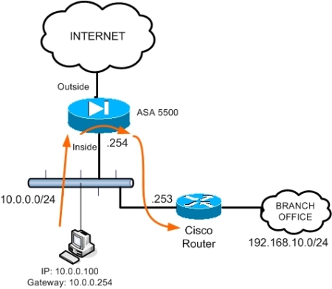
Interfaces with Same Security Level
Enables communication between interfaces with the same security level or allows traffic to enter and exit the same interface
DMZ Network
GigabitEthernet0/2
Security level 100
Interface name = dmz
g0/2
Internet
g0/0
g0/1
Inside Network
GigabitEthernet0/1
Security level 100
Interface name = inside
ciscoasa(config)#
same-security-traffic permit {inter-interface | intra-interface}
asa1(config)# same-security-traffic permit inter-interface

Slide 36
Assign Interface IP Address
g0/2
Assigns an IP address to each interface
Internet
g0/0
g0/1
GigabitEthernet0/0
Interface name = outside
IP address = 192.168.1.2
ciscoasa(config-if)#
ip address ip_address [mask] [standby ip_address]
asa1(config)# interface GigabitEthernet0/0
asa1(config-if)# nameif outside
asa1(config-if)# security-level 0
asa1(config-if)# ip address 192.168.1.2 255.255.255.0

Slide 37
Assign an Interface Speed and Duplex
GigabitEthernet0/0
Speed =1000
Duplex = full
Enable the interface speed and duplex
g0/2
Internet
g0/0
g0/1
ciscoasa(config-if)#
speed {10 | 100 | 1000 | auto | nonegotiate}
duplex {auto | full | half}
asa1(config)# interface GigabitEthernet0/0
asa1(config-if)# nameif outside
asa1(config-if)# ip address 192.168.1.2
asa1(config-if)# security-level 0
asa1(config-if)# speed 1000
asa1(config-if)# duplex full

Slide 38

ASA Management Interface
Disables management-only mode (for ASA 5520, 5540 and 5550)
Management0/0
Management only = no
g0/2
m0/0
Internet
g0/0
g0/1
ciscoasa(config-if)#
management-only
Configures an interface to accept management traffic only
no management-only
Disables management-only mode
asa1(config)# interface management0/0
asa1(config-if)# no management-only

Slide 39
Enabling and Disabling Interfaces
g0/2
Internet
g0/0
g0/1
GigabitEthernet0/0
Enabled
ciscoasa(config-if)#
shutdown
Disables an interface
no shutdown = enabled
asa1(config)# interface GigabitEthernet0/0
asa1(config-if)# no shutdown
Disables management-only mode (for ASA 5520, 5540 and 5550)

Slide 40
Configure a Static Route
Defines a static or default route for an interface
Default Route
Static Route
Internet
10.0.1.102
10.1.1.11
192.168.1.1
ciscoasa(config)#
route if_name ip_address netmask gateway_ip [metric]
10.1.1.4
asa1(config)# route outside 0.0.0.0 0.0.0.0 192.168.1.1 1
asa1(config)# route inside 10.1.1.0 255.255.255.0 10.0.1.102 1

Slide 41
DHCP Server
DHCP
Assigned
GigabitEthernet0/1
Interface name = inside
IP address = 10.0.1.1
Internet
g0/1
dhcpd address 10.0.1.101-10.0.1.110 inside
dhcpd dns 8.8.8.8 8.8.4.4
dhcpd lease 3000
dhcpd enable inside
dhcpd option 3 ip 10.0.1.1
show dhcpd binding all

Slide 42
Configuration Example
172.16.1.0
.1
Internet
192.168.1.0
10.0.1.0
10.1.1.0
.2
.1
.1
GigabitEthernet0/0
Interface name = outside
Security level = 0
IP address = 192.168.1.2
GigabitEthernet0/1
Interface name = inside
Security level = 100
IP address = 10.0.1.1
asa1(config)# write terminal
. . .
interface GigabitEthernet0/0
speed 1000
duplex full
nameif outside
security-level 0
ip address 192.168.1.2 255.255.255.0
interface GigabitEthernet0/1
speed 1000
duplex full
nameif inside
security-level 100
ip address 10.0.1.1 255.255.255.0 . . .

Slide 43
Configuration Example (Cont.)
GigabitEthernet0/2
Interface name = dmz
Security level = 50
IP address = 172.16.1.1
“bastionhost”
172.16.1.2
“insidehost”
10.1.1.11
172.16.1.0
192.168.1.0
.1
10.0.1.0
10.1.1.0
Internet
.2
.1
.1
interface GigabitEthernet0/2
nameif dmz
security-level 50
speed 1000
duplex full
ip address 172.16.1.1 255.255.255.0
passwd 2KFQnbNIdI.2KYOU encrypted
hostname asa1
names
name 172.16.1.2 bastionhost
name 10.1.1.11 insidehost

Slide 44
Configuration Example (Cont.)
“bastionhost”
172.16.1.2
Default Route
172.16.1.0
.2
Static Route
“insidehost”
10.1.1.11
192.168.1.0
.1
10.0.1.0
10.1.1.0
Internet
.1
.2
.1
.102
.1
route outside 0.0.0.0 0.0.0.0 192.168.1.1 1
route inside 10.1.1.0 255.255.255.0 10.0.1.102 1

Slide 45
PHẦN 5
Advanced Security Appliance Configuration

Slide 46
access-list Command
Permit
Inbound
HTTP
DMZ
172.16.1.2
Public Web Server
192.168.1.9
Inside
Internet
192.168.1.0
.1
.2
10.0.1.0
Outside
asa1(config)# access-list ACLOUT permit tcp any host 192.168.1.9 eq www
Permits outside HTTP traffic to access the public web server

Slide 47
access-group Command
Apply ACL
to interface
DMZ
Public Web
Server
Inside
Internet
192.168.1.0
.1
.2
10.0.1.0
Outside
ciscoasa(config)#
access-group access-list {in | out} interface interface_name [per-user-override]
Applies an ACL to an interface
asa1(config)# access-group ACLOUT in interface outside

Slide 48
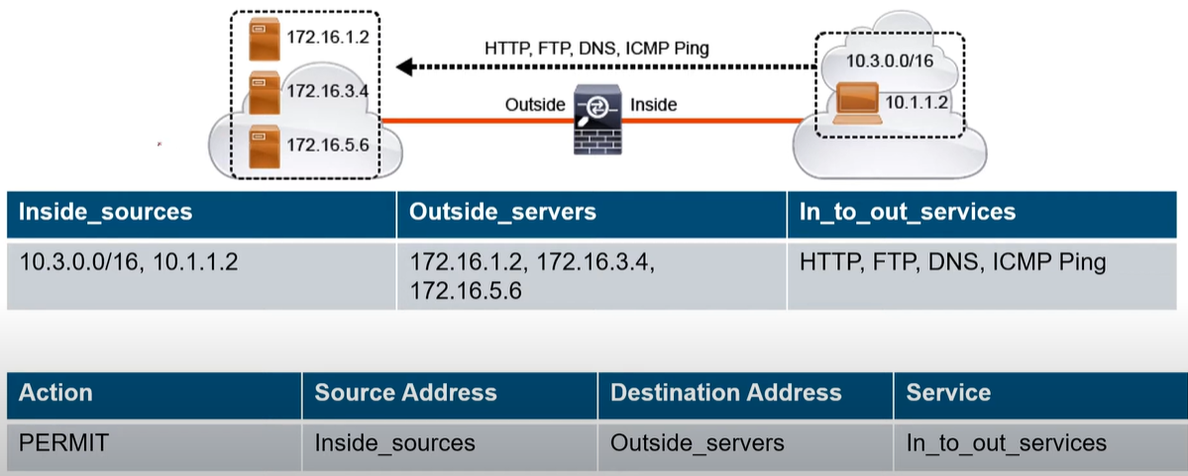
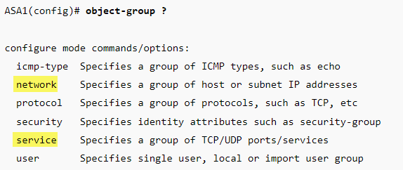
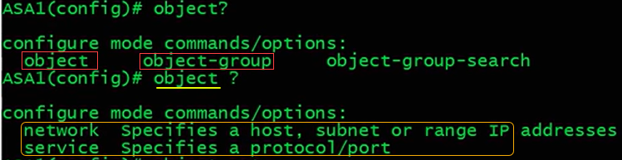
Object, Object-group & ACL
object network HQ_NET subnet 192.168.10.0 255.255.255.128 object network HQ_SERVER host 192.168.20.10
!
object-group network HQ_NETWORK network-object object HQ_NET
network-object object HQ_SERVER
network-object host 192.168.3.1
!
access-list HTTP_TO_HQ permit tcp any object-group HQ_NETWORK eq 80

Slide 49
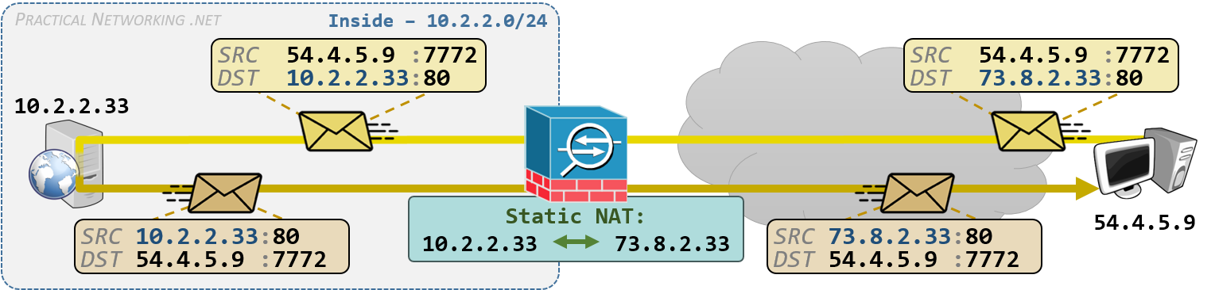
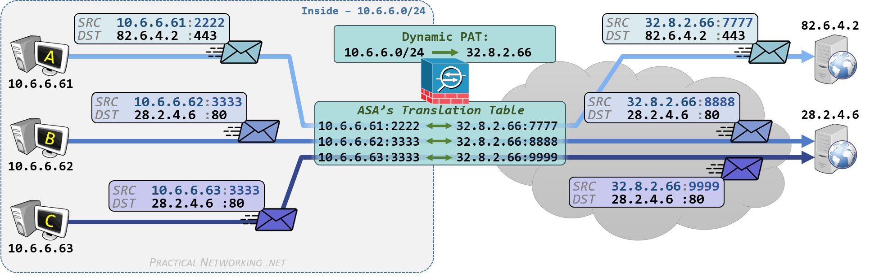
Object & NAT
object network WEB_SERVER
host 10.2.2.33
nat (inside,outside) static 73.8.2.33
object network INSIDE
subnet 10.6.6.0 255.255.255.0
nat (inside,outside) dynamic interface

Slide 50
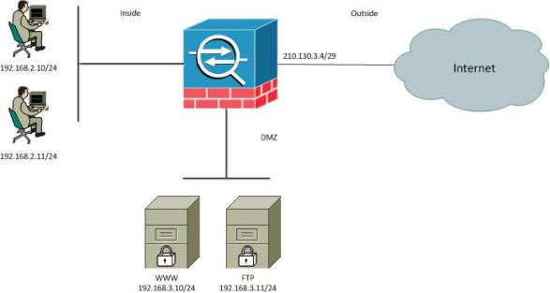
Static NAT: (One to One)
1. Create object group.
2. Define object IP address.
3. Create NAT statement within object group.
4. Create access-list
5. Assign access-group to interface
object network WEB_SERVER
host 192.168.3.10
nat (DMZ,outside) static 210.130.3.5
access-list OUTSIDE extended permit tcp any host 210.130.3.5 eq 80
access-group OUTSIDE in interface outside

Slide 51
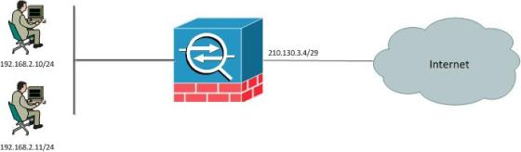
Dynamic NAT: (Many to One)
1. Create object group.
2. Define object IP address.
3. Create NAT statement within object group.
4. Create access-list
5. Assign access-group to interface
object network INSIDE_LAN
subnet 192.168.2.0 255.255.255.0
nat (inside,outside) dynamic interface
access-list standard INSIDE permit ip 192.168.2.0 0.0.0.255
access-group INSIDE in interface inside

Slide 52
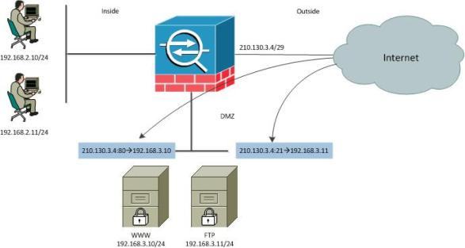
Port Forwarding
1. Create object group.
2. Define object IP address.
3. Create NAT statement within object group.
4. Create access-list
5. Assign access-group to interface
object group WWW_SERVER
host 192.168.3.10
nat (DMZ,outside) static 210.130.3.4 service tcp 80 80
object group FTP_SERVER
host 192.168.3.11
nat (DMZ,outside) static 210.130.3.4 service tcp 21 21
access-list OUTSIDE_IN extended permit tcp any host 192.168.3.10 eq 80
access-list OUTSIDE_IN extended permit tcp any host 192.168.3.10 eq 21
access-group OUTSIDE_IN in interface outside

Slide 53
Allow ICMP
Internet
Outside
Inside
ICMP Echo, Unreachable, time-exceeded
access-list OUTSIDE_IN extended permit icmp any any
access-group OUTSIDE_IN in interface outside
access-list OUTSIDE_IN extended permit icmp any any echo-reply
access-list OUTSIDE_IN extended permit icmp any any unreachable
access-list OUTSIDE_IN extended permit icmp any any time-exceeded
access-group OUTSIDE_IN in interface outside

Slide 54
PHẦN 6
ASDM Overview and Operating Requirements

Slide 55
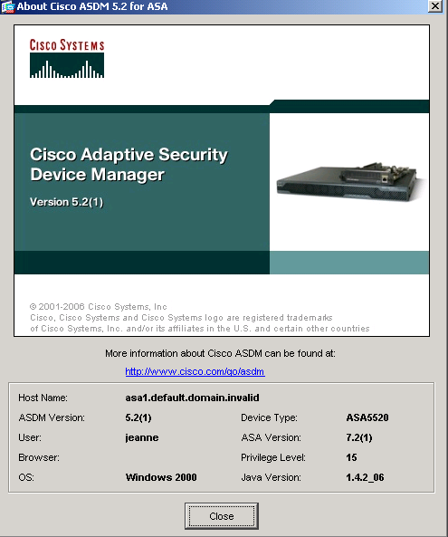
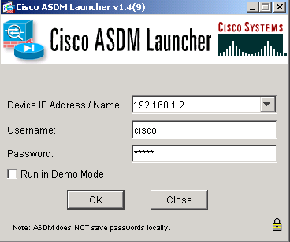
What Is ASDM?
ASDM is a browser-based configuration tool designed to help configure and monitor your security appliance.
Internet
SSL Secure Tunnel

Slide 56



Supported Platforms
Windows
Sun Solaris
Linux

Slide 57
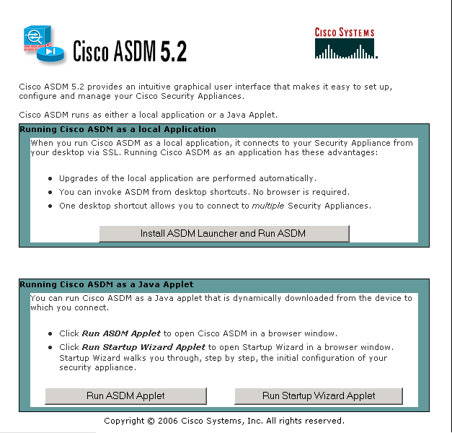
Running ASDM
Run ASDM as a:
Local application
Java applet
Launch Startup Wizard

Slide 58
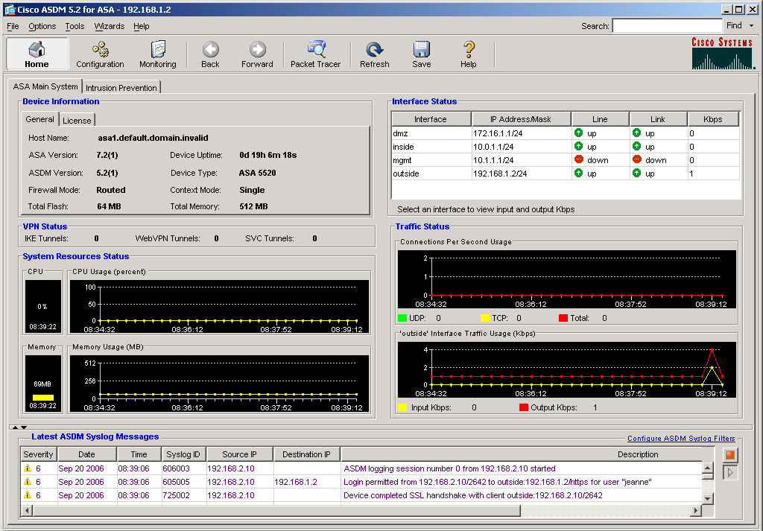
ASDM Home Window
Menu bar
Main toolbar
Device
Information
General
License
Interface
Status
VPN Status
System
Resources
Traffic
Status
Syslog
Messages

Slide 59
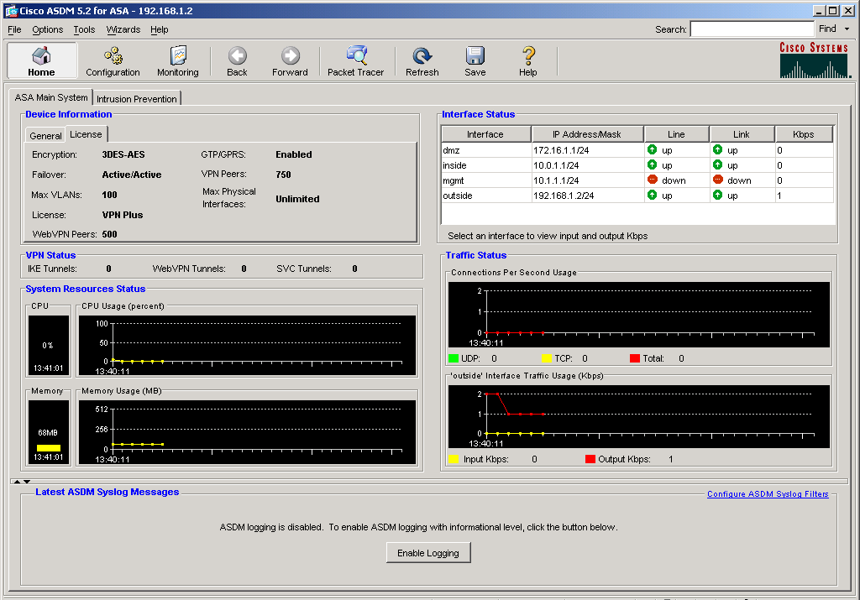
ASDM Home Window (Cont.)
License tab

Slide 60
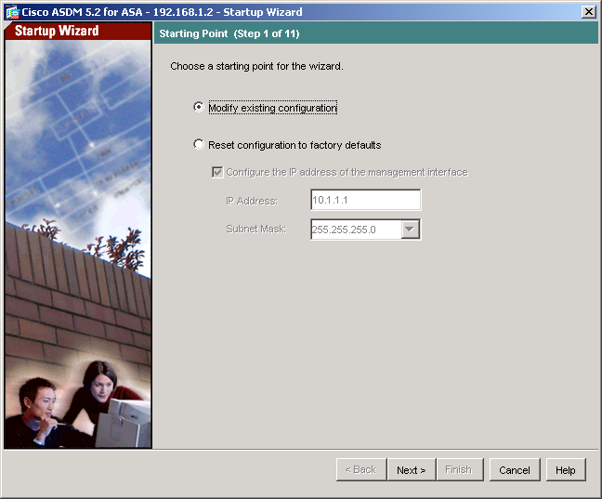
Startup Wizard
Startup Wizard
Interfaces
NAT and PAT
Hostname
Domain name
Enable password

Slide 61
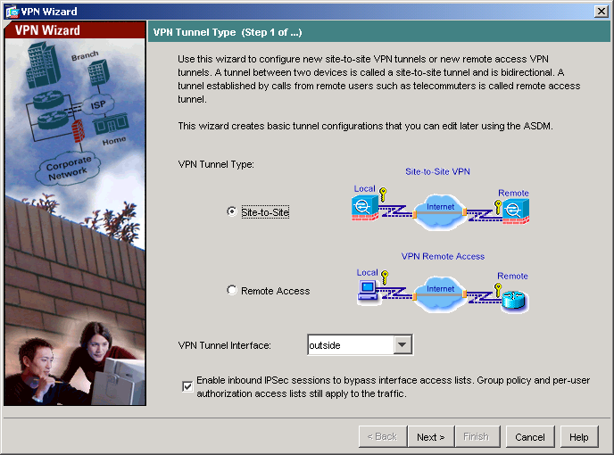
VPN Wizard
VPN Wizard
Site-to-Site
Remote Access
Note: Use Configuration > VPN to edit VPN connections.

Slide 62
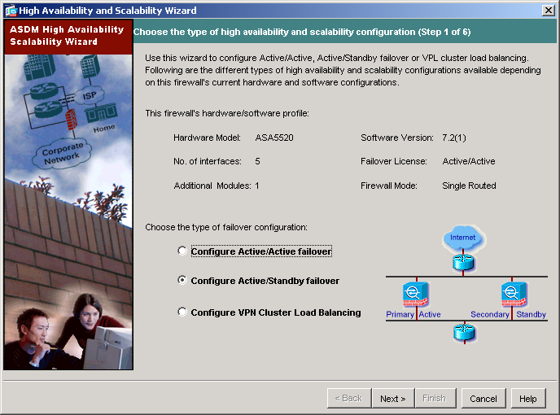
High Availability and Scalability Wizard
High Availability and Scalability Wizard
Active/Active Failover
Active/Standby Failover
VPN Cluster Load Balancing

Slide 63
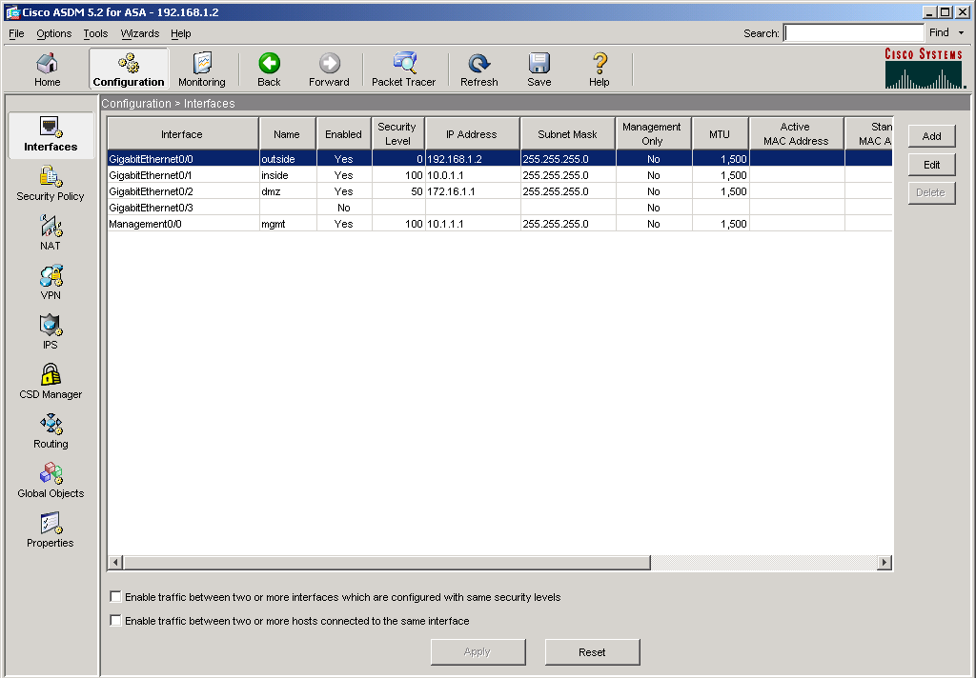
Configuration Window
Configuration
Interface
Security Policy
NAT
VPN
IPS or
CSD Manager
Routing
Global Objects
Properties

Slide 64
Interfaces
IP address
Static
DHCP
Same security level

Slide 65
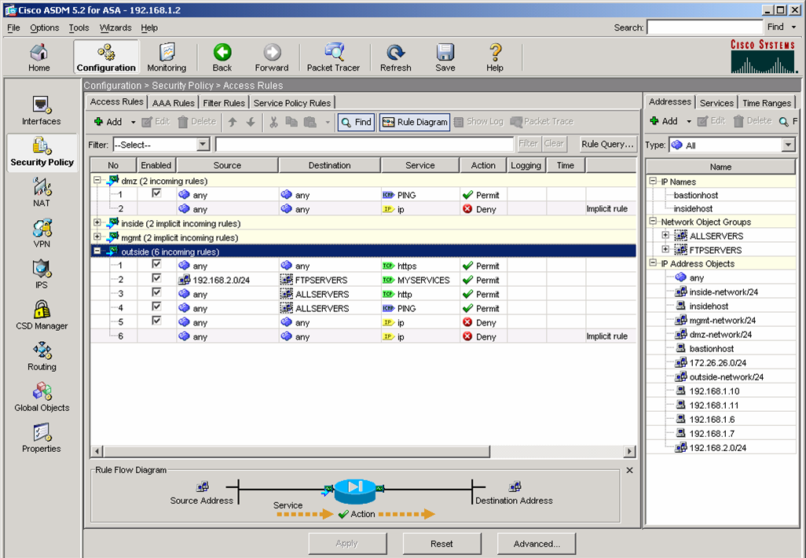
Security Policy
Access Rules
AAA Rules
Filter Rules
Service Policy Rules

Slide 66
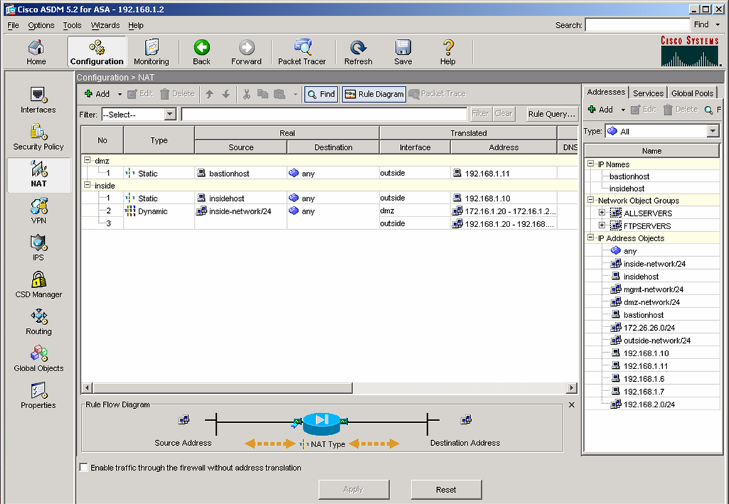
NAT
Translation Rules
NAT
Policy NAT
NAT exemption
Maximum connections
Embryonic connections
NAT0

Slide 67
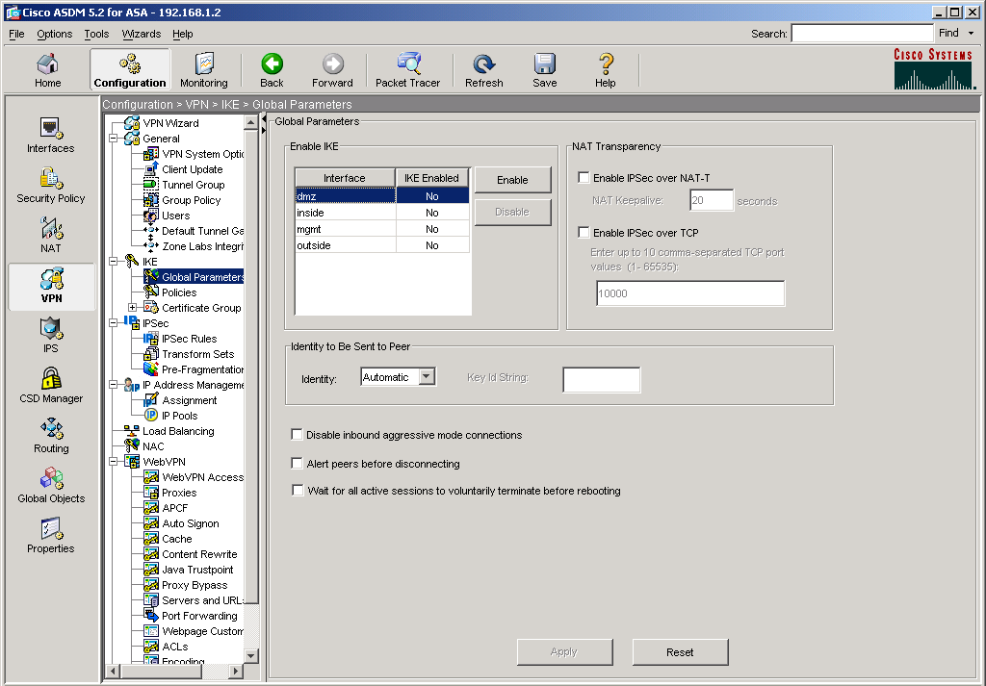
VPN
Edit VPN
General
IKE
IPsec
IP Address Management
Load Balancing
NAC
WebVPN
E-Mail Proxy
Note: Use the Remote Access or Site-to-Site VPN Wizard for new VPN connections.

Slide 68
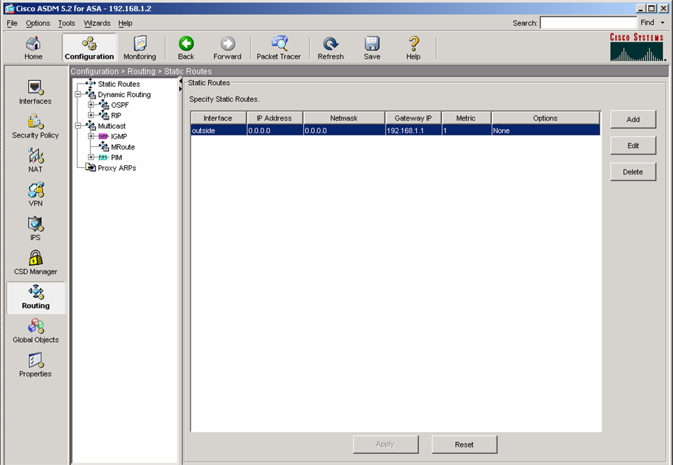
Routing
Static Routes
Dynamic Routing
OSPF
RIP
Multicast
IGMP
MRoute
PIM
Proxy ARPs

Slide 69
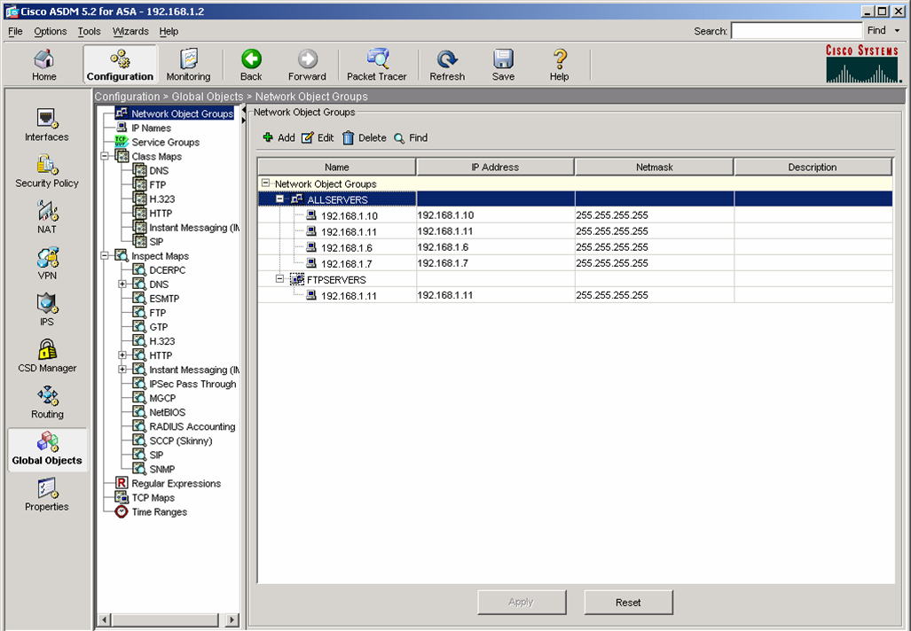
Global Objects
Network Object Groups
IP Names
Service Groups
Class Maps
Inspect Maps
Regular Expressions
TCP Maps
Time Ranges

Slide 70
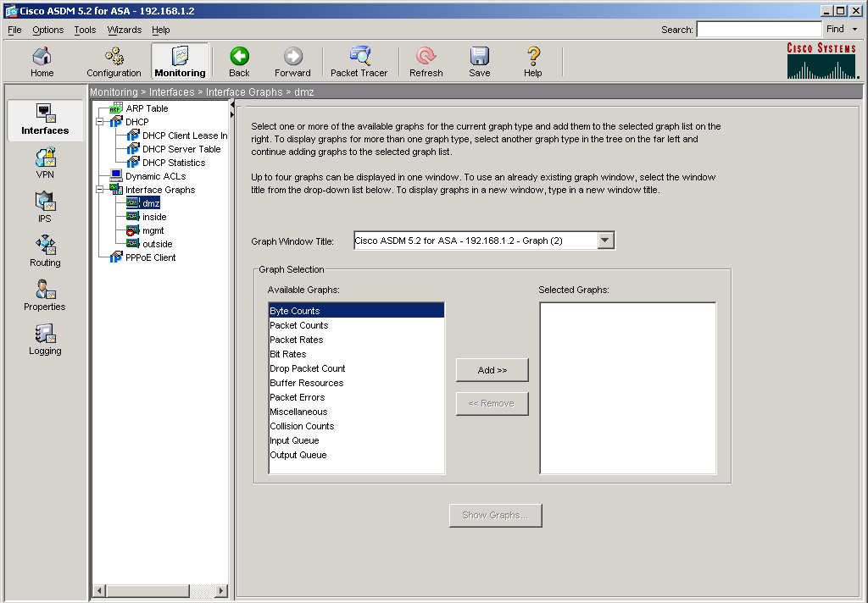
Monitoring Button
Interfaces
VPN
IPS or Trend Micro Content Security
Routing
Properties
Logging

Slide 71
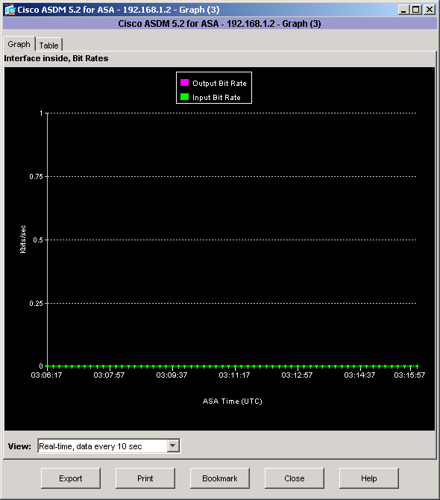
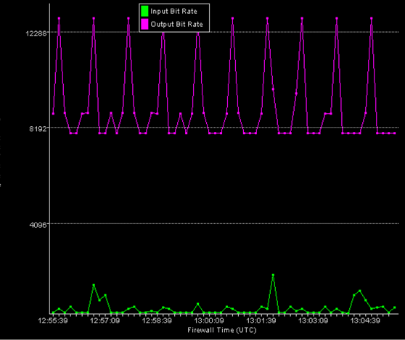
Interface Graphs Panel
The Interface Graphs panel enables you to monitor per-interface statistics, such as bit rates, for each enabled interface on the security appliance.

Slide 72
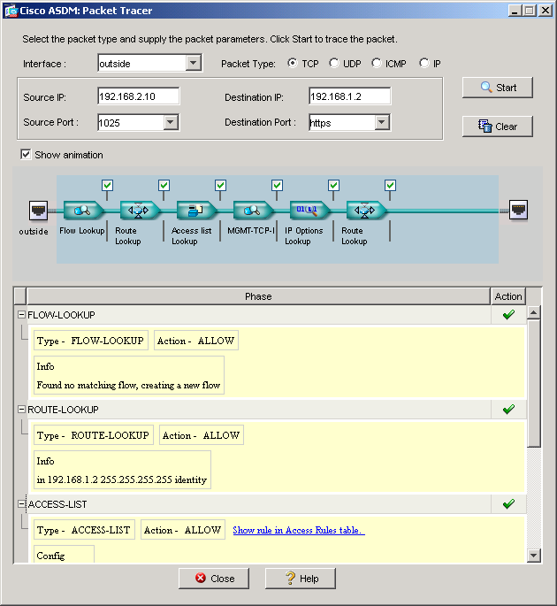
Packet Tracer
Interface
Source IP
Destination IP
Source port
Destination port
Flow lookup
Route lookup
Access list

Slide 73
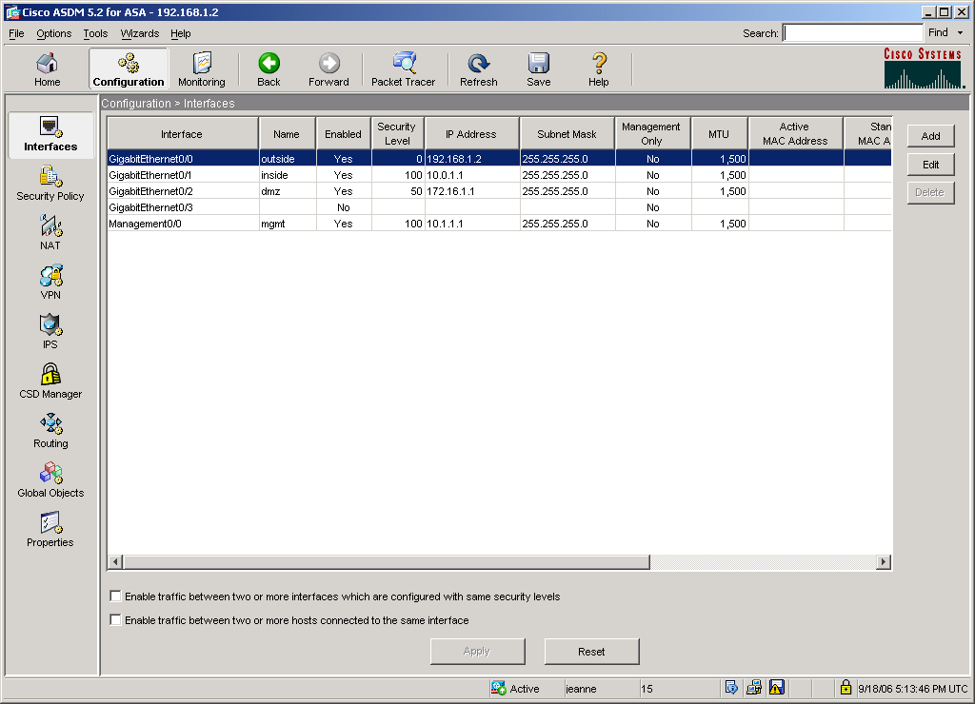
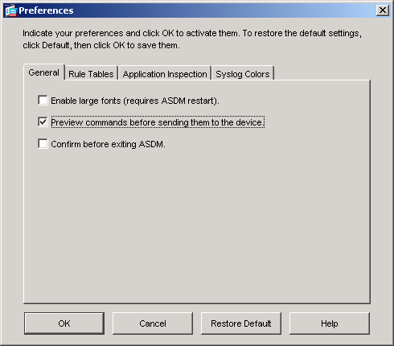
Options > Preferences
Options

Slide 74
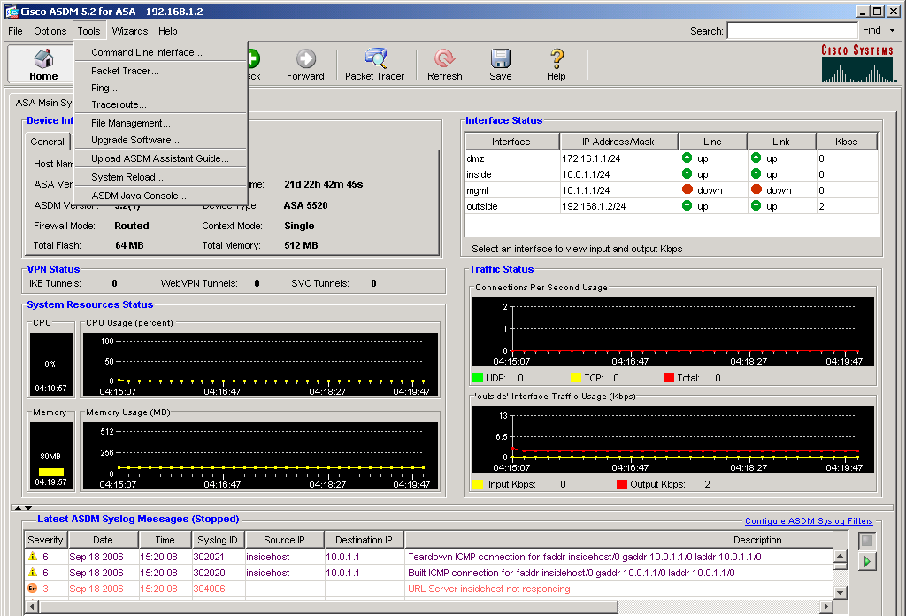
Tools
Tools
Command Line Interface
Packet Tracer
Ping
Traceroute
File Management
Ugrade Software
Upload ASDM Assistant Guide
System Reload
ASDM Java Console

Slide 75

Thảo luận

